Slide 1
You’re Fat! Is Psychological Flexibility Related to Stigmatizing Experiences and Disordered Eating for the Obese?
Emily R. Squyres
Emily K. Sandoz
Louisiana Contextual Science
Research Group

Slide 2
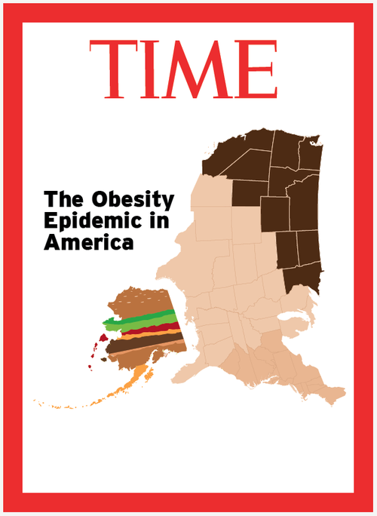
Notes:
Stats
Obesity rates have been rising worldwide
They are highest in the US
Adult obesity has doubled since the 1980’s and child obesity has tripled.
Presently we have ~ 36% of the adult population and ~17% of children battling obesity
The US Center of Disease Control & Prevention estimates that by 2030 we could be facing 42% of the adult population being obese.

Slide 3
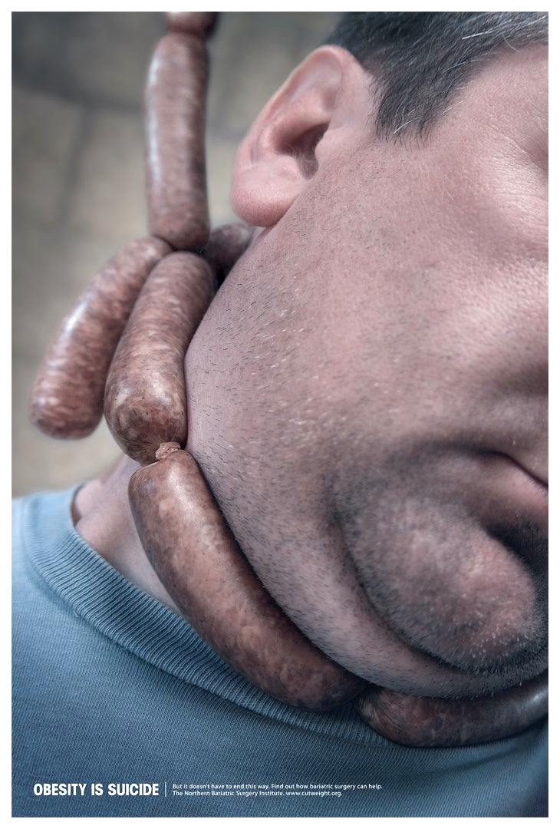
Notes:
There’s a reason to be concerned due to the illness and disability associated with obesity
Physical: High blood pressure, stroke, heart disease, diabetes, increased risk of cancer
Disability: Obese person without any obesity related medical conditions is two times more likely to be disabled than a person of average weight.
Ultimately: death….2.8 million people die world wide every year due to being overweight or obese
Psychological: comorbid with mood disorders, mania, agoraphobia without panic disorder, addictive disorders, binge eating
Decreased quality of life-
Multiple domains: physical functioning, self-esteem, sexual functioning, work life and public distress.
children and teens report QoL levels similar to children being treated for cancer.
If we’re talking about medical or psychological issues they become more severe with increasing BMI.

Slide 4
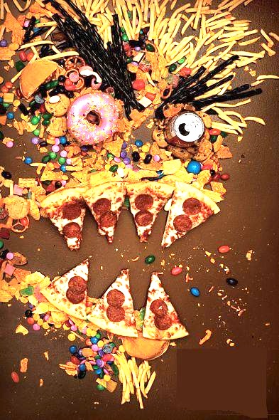
Notes:
Disorganized Eating behaviors are commonly seen among the obese
The two eating related disorders that are frequently seen in obese populations are:
Binge eating. Involves eating larger quantities of food than most people would eat in the same context.
Night eating- Eating large meals late at night or snacking throughout the evening hours
BINGE EATING BEHAVIOR
~30% of population of treatment seeking obese people meet criteria for BED, which is higher than the prevelance in the general population.
~20% of the obese population engage in binging episodes but do not meet criteria for BED
BE is positively correlated with BMI, especially for those who are considered morbidly obese (BMI >35)
NIGHT EATING BEHAVIOR
Prev- .4% normal pop & 15% of obese pop
- Obese are 5X more likley to suffer from NES
BEHAVIORS SEEN IN BED AND NES: Overeating, eating quickly, eating for comfort or to cope, loss of control,

Slide 5
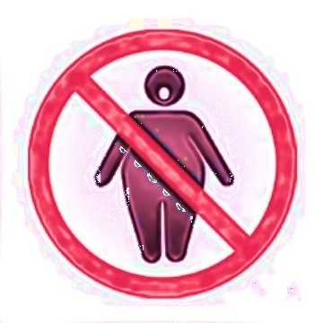
Notes:
STIGMA & STEREOTYPES
Disordered eating issues are pretty common among the obese. Unfortunately so are stigmatizing experiences.
Common Stereotypes of obese: as lazy, self-indulgent, unattractive, bad, and worthless
At the root of these stereotypes is the ongoing public perception that obesity is EASILY within the individual’s control.
So, this boils down to not only are the obese lazy, self-indulgent, unattractive, bad, and worthless, but they are to blame.
This is even the case with formerly obese folks. Still stereotyped as if they are tainted.
WHO & WHERE?
Employers, coworkers, neighbors, students, teachers, doctors, nurses, family, friends….everyone & everywhere.
IMPACTS
Salaries at work, GPA in schools, friendships, family ties.
Physical health- avoidance of seeking healthcare maintenance
P??????sychological health- depressive symptoms, self-esteem issues, body image dissatisfaction, binge eating disorder and anxiety.
Weight Loss Behaviors- People are less responsive to interventions focusing on healthy eating and physical activity when they are exposed to stigma.
Experience of obesity stigma also predicts disordered eating
Increased caloric intake and binge eating function as a coping mechanism in response to stigma.---as reported by 79% in a sample
LEAD INTO SELF-STIGMA

Slide 6
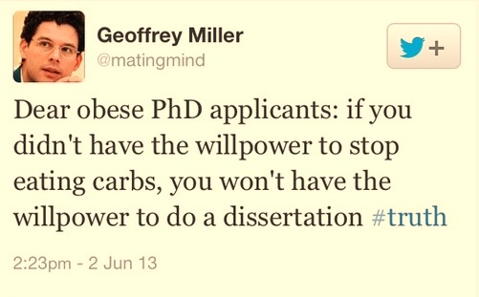

Slide 7
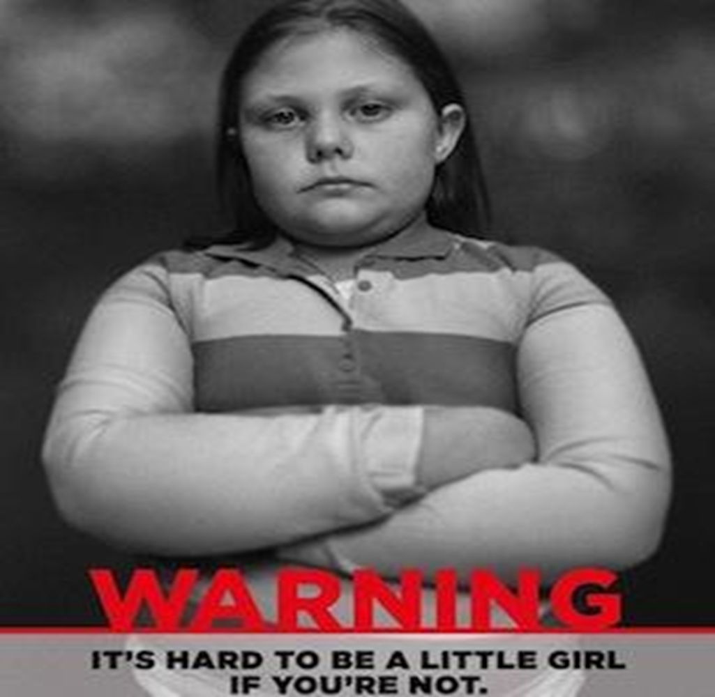
Notes:
SELF-STIGMA & THE COSTS
Self-Stigma
A person’s implicit belief and attitude about themselves as a result of negative stereotypes about weight and shape.
Explain In-group/out-group bias that is typically seen with “normal” weight. Aka- Social Identity Theory- Tajfel & Turner
Obese people don’t hold with this. We tend to look at members of our own group (other overweight people) with a negative attitude.
Obese ppl internalize the stigma they experience, exhibiting self-stigma, blaming themselves for the way others treat them. (Vartanian & Novak).
Costs of OSS:
Amplifies the effects of stigma: body image dissatisfaction, anxiety, depression, BEE & low self-esteem.
Also contributes to decreases in health related quality of life
Also amplifies the way that stigma contributes to remaining obese…
So- coping with O stigma becomes exercise avoidance and disordered eating-> Continued weight gain is inevitable!
Higher BMI = increased sensitivity to stigmatizing experiences and severity of self-stigma.
This cycle of avoidant coping characterizes psychological inflexibility

Slide 8
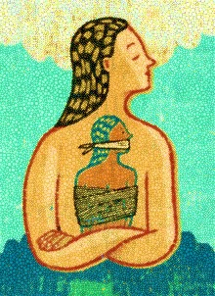
Notes:
PSYCHOLOGICAL INFLEXIBILIY
Psychological inflexibility involves the inability to engage in purposeful, values-based action because of cognitive rigidity and experiential avoidance.
Psychological inflexibility is associated with psychological suffering and poor physical health in many different health-related areas like chronic pain and diabetes.
To be psychologically flexible means to be able to fully experience one’s thoughts and feelings in order to move towards personal values. This ability is important for physical health and health-related behaviors.
Psychological inflexibility predicts emotional and uncontrolled eating.
Psyc. Inflex with weight and food cravings contributes to disordered eating.
So, I wanted to look at the relationship between obesity stigma and disordered eating and see if p. flex was involved

Slide 9
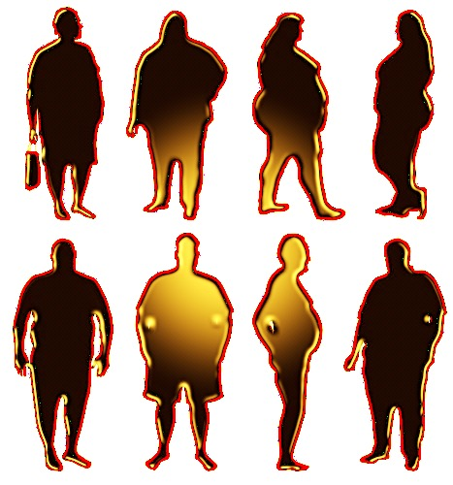
Notes:
METHODS:
Participants- patients at a local bariatric clinic and through Facebook.
Have a BMI ≥ 23 (the technical designation of being overweight) and a smart phone.
2. Procedure:
Complete initial questionnaire packet
Next 7 days, participants will receive 3 text messages everyday that include a link to the PASE (Periodic Assessment of Stigmatizing Experiences), and a fourth text message that includes a link to the DES (Daily Eating Survey) .

Slide 10
Initial Questionnaire Packet
Demographics
Acceptance & Action Questionnaire-II (AAQ-II)
Acceptance & Action Questionnaire- Weight (AAQ-W)
Acceptance & Action Questionnaire for Food (FAAQ)
Weight Self-Stigma Questionnaire (WSSQ)
Night Eating Questionnaire (NEQ)
Eating Loss of Control Survey (ELOCS)
Notes:
WSSQ- Two different subscales- Self-Devaluation and Fear of Enacted Stigma

Slide 11
EMA Measures
Periodic Assessment of Stigmatizing Experiences (PASE)
Weight Discrimination
Self-Blame
Eating as Escape
Avoidance of Weight Distress
Weight
Stigma
Notes:
PASE
Weight stigma
Weight Discrimination
Self-Blame
Eating as Escape
Avoidance of Weight Distress

Slide 12
Daily Eating Survey (DES)
Eating as Comfort
Difficulty Controlling Emotions
Intolerance of Food Thoughts
Overeating
Loss of Control
Eating Quickly
Lack of Self-Acceptance
Eating-Related Guilt
EMA
Measures
Notes:
DES
Eating as comfort
Difficulty Controlling Emotions
Intolerance of Food Thoughts
Lack of Self-Acceptance
Overeating
Loss of Control
Eating Quickly
Eating-related Guilt
Daily Eating Survey (DES)
8-item survey
“I ate my food quickly today, not really paying attention
to what I was eating”

Slide 13
Notes:
Hypothesis 1: Obesity stigma -> disordered eating
Initial Questionnaires- DON’T HAVE A TABLE FOR THIS!!
Perceived stigmatizing experiences as measured by the WSSQ were found to significantly predict disordered eating as measured by the ELOCS and by the NEQ such that increases in weight-related stigmatizing experiences predicted increases in disordered eating.
PASE & DES
Perceived Stigma predicted Eating as Escape
(M_{b}= .38, SD_{b} = .94, p = .01)
This suggest that stigmatizing experiences may have impacted participants’ perception of why they ate, but not necessarily how they ate.

Slide 14
Notes:
Hypothesis 2: Weight & food inflexibility will moderate the relationship between stigmatizing experiences and disordered eating.
Initial questionnaires
no significant interactions found
Holding AAQF constant, WSSQ predicted NES & ELOCS
Holding WSSQ constant, AAQW predicted ELOCS after accounting for WSSQ
EMA data- No significant findings

Slide 15
Notes:
Hypothesis 3: Self-stigma will moderate the relationship between stigmatizing experiences and disordered eating.
No significant results were found for initial questionnaires or EMA
Could be due to: relatively high levels of self-stigma reported by this sample compared to the normative sample.
AND that whether or not perceived stigma is coupled with self-stigma is less important in predicting disordered eating than whether perceived stigma is met with inflexibility.
Hypothesis 4: Psychological inflexibility will predict self-stigma.
Initial Questionnaire
AAQ-II -> self-devaluation AND fear of enacted stigma (both measured by WSSQ)
AAQ-W -> self-devaluation AND fear of enacted stigma
Food inflexibility did not predict self-stigma on either subscales.
EMA
there were two models found to significantly predict self-stigma from one of the dimensions of psychological inflexibility.
Avoidance of weight related distress -> Self-Blame
Eating as Comfort -> Lack of self-Acceptance
In both cases, as inflex increased, so did self-stigmatization
This suggests first that:
efforts to avoid painful thoughts or feelings about weight, in any form, may contribute specifically to the self-blame aspect of stigma (i.e., blaming oneself for others’ judgments).
It also suggests that eating to escape pain, of any sort, may contribute specifically to the lack of self-acceptance aspect of stigma.

Slide 16
Notes:
DISCUSSION
Overall, weight-related and food inflexibility
food inflexibility did not moderate any relationships between perceived stigma, and disordered eating variables. Food inflexibility was also correlated only with night eating and self-stigma, and was unrelated to eating loss of control. All in all, the data seemed to suggest that food inflexibility was less important, than overall or weight related inflexibility, for predicting self-stigma, predicting disordered eating, or moderating the relationship between stigma and disordered eating.
It may be that efforts to curb or ignore food-related thoughts and feelings are simply not as relevant to disordered eating or stigma in an overweight nonclinical sample (i.e., not actively seeking weight-loss). After all, this sample demonstrated more flexibility than the undergraduate sample on which the FAAQ was normed and in which the relations between food-related inflexibility and disordered have been observed
LIMITATIONS
Small sample size restricted power
Only 4 bariatric clients expressed an interest while 71 did from Facebook.
Of the 4 bariatric clients only two consented to participate while 50 did from FB
Lack of diversity: primarily female and all caucasian
This sample showed fewer problems with loss of control around eating and food inflex than normative samples. Could be due to willingness to participate
Missing responses from EMA data.
Of 21 opportunities to complete PASE data the average completion was 15.2
Of 7 chances to complete DES data the average completion was 6.1
This caused instability among linear models due to fewer numbers of observations.
67% of ppl responded with the same answer every day on at least one item creating slopes of zero, making it difficult to decern effects.
Design flaw with wording of EMA items.
“My eating urges control me,” -→ TODAY
CONCLUSION
suggest that while perceived stigmatizing experiences may result in emotional eating, these experiences only predict objective problematic eating amongst those high in overall or weight-related inflexibility. This study also suggests that inflexibility contributes substantially to self-stigma amongst the obese, particularly when it 1) takes the form of eating and 2) is focused around weight-related distress.
The results of this study suggest that similar flexibility-based interventions could be designed specifically to reduce self-stigma and buffer the impact of stigmatizing experiences on disordered eating. Such an intervention might train flexibility-based coping skills to replace emotional eating, while building weight-related flexibility to decrease the likelihood of impact of stigma on objective eating behavior.

Slide 17
Notes:
FUTURE
Psyc. Inflex is composed of six interdependent components
May want to look at specific components with regards to psyc inflex, disordered eating and self-stigma and perceived stigma.
Cognitive fusion- rigidity of ideas-
Various populations of dieting, non-dieting, bariatric before and after, etc.
Extend EMA data over the course of treatment surgery prep, etc.
Including a component to look at differences in social interactions and social skills

Slide 18
Laissez les bon temps roulet!
Emily Squyres
ers019@latech.edu
Emily Sandoz
emilysandoz@louisiana.edu
Louisiana Contextual Science
Research Group

